Slide 1


`````
`
B15
AirBnB Analytics
Madrid
Introduction to our visual system
2017
Abheek Dutta, Côme de Germay, Hanrui Wang, Johnny Choi
Ming Sutaruksanon, Qin Zhizhen, Samuel Fuchs
2021.10.17

Slide 2
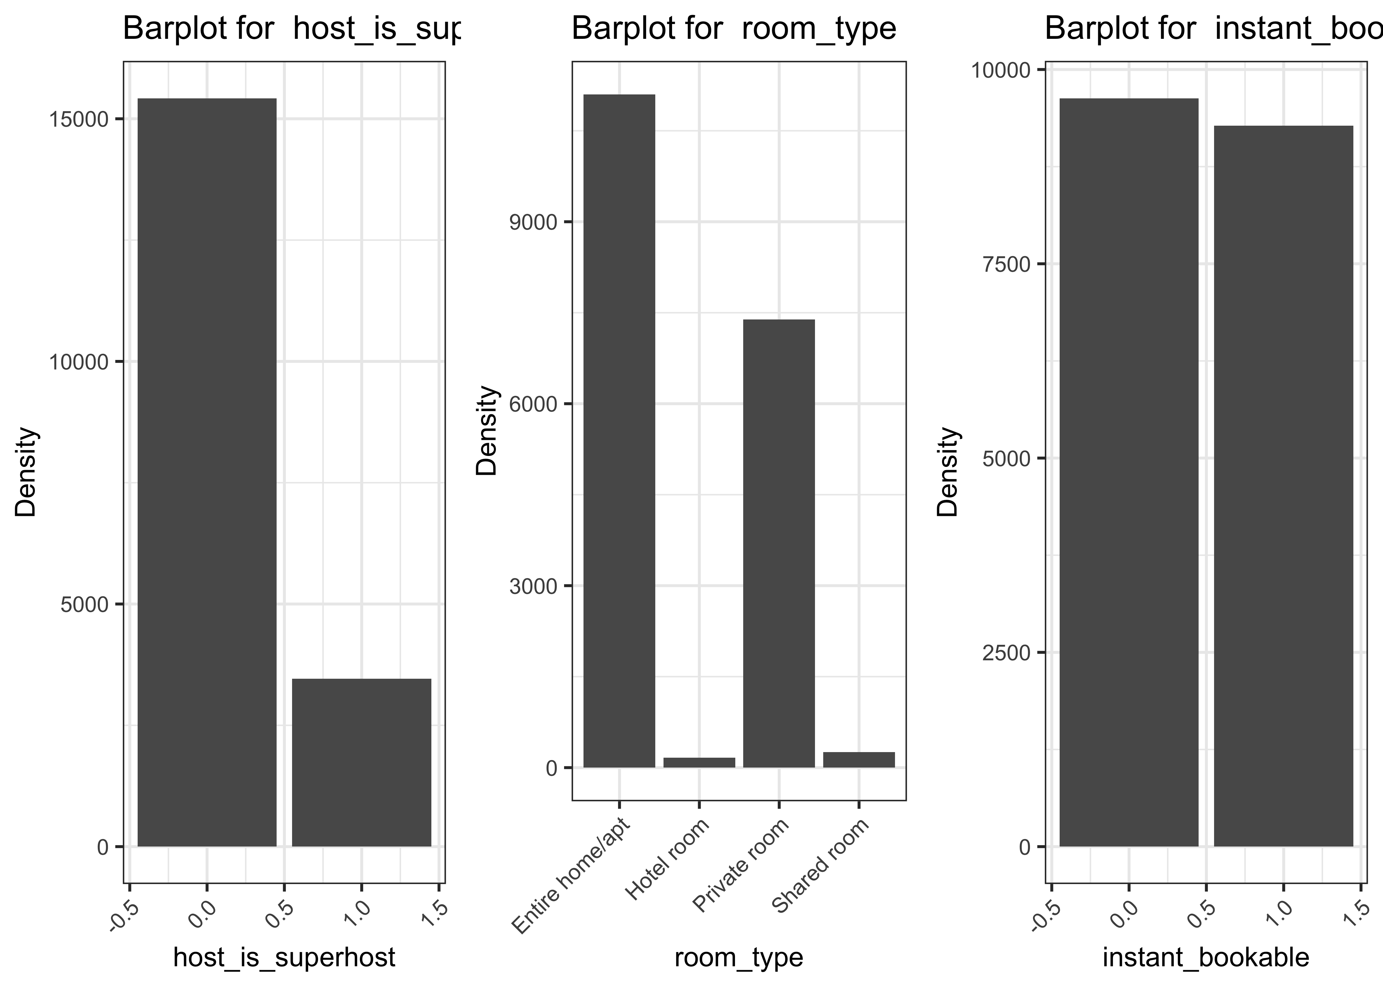
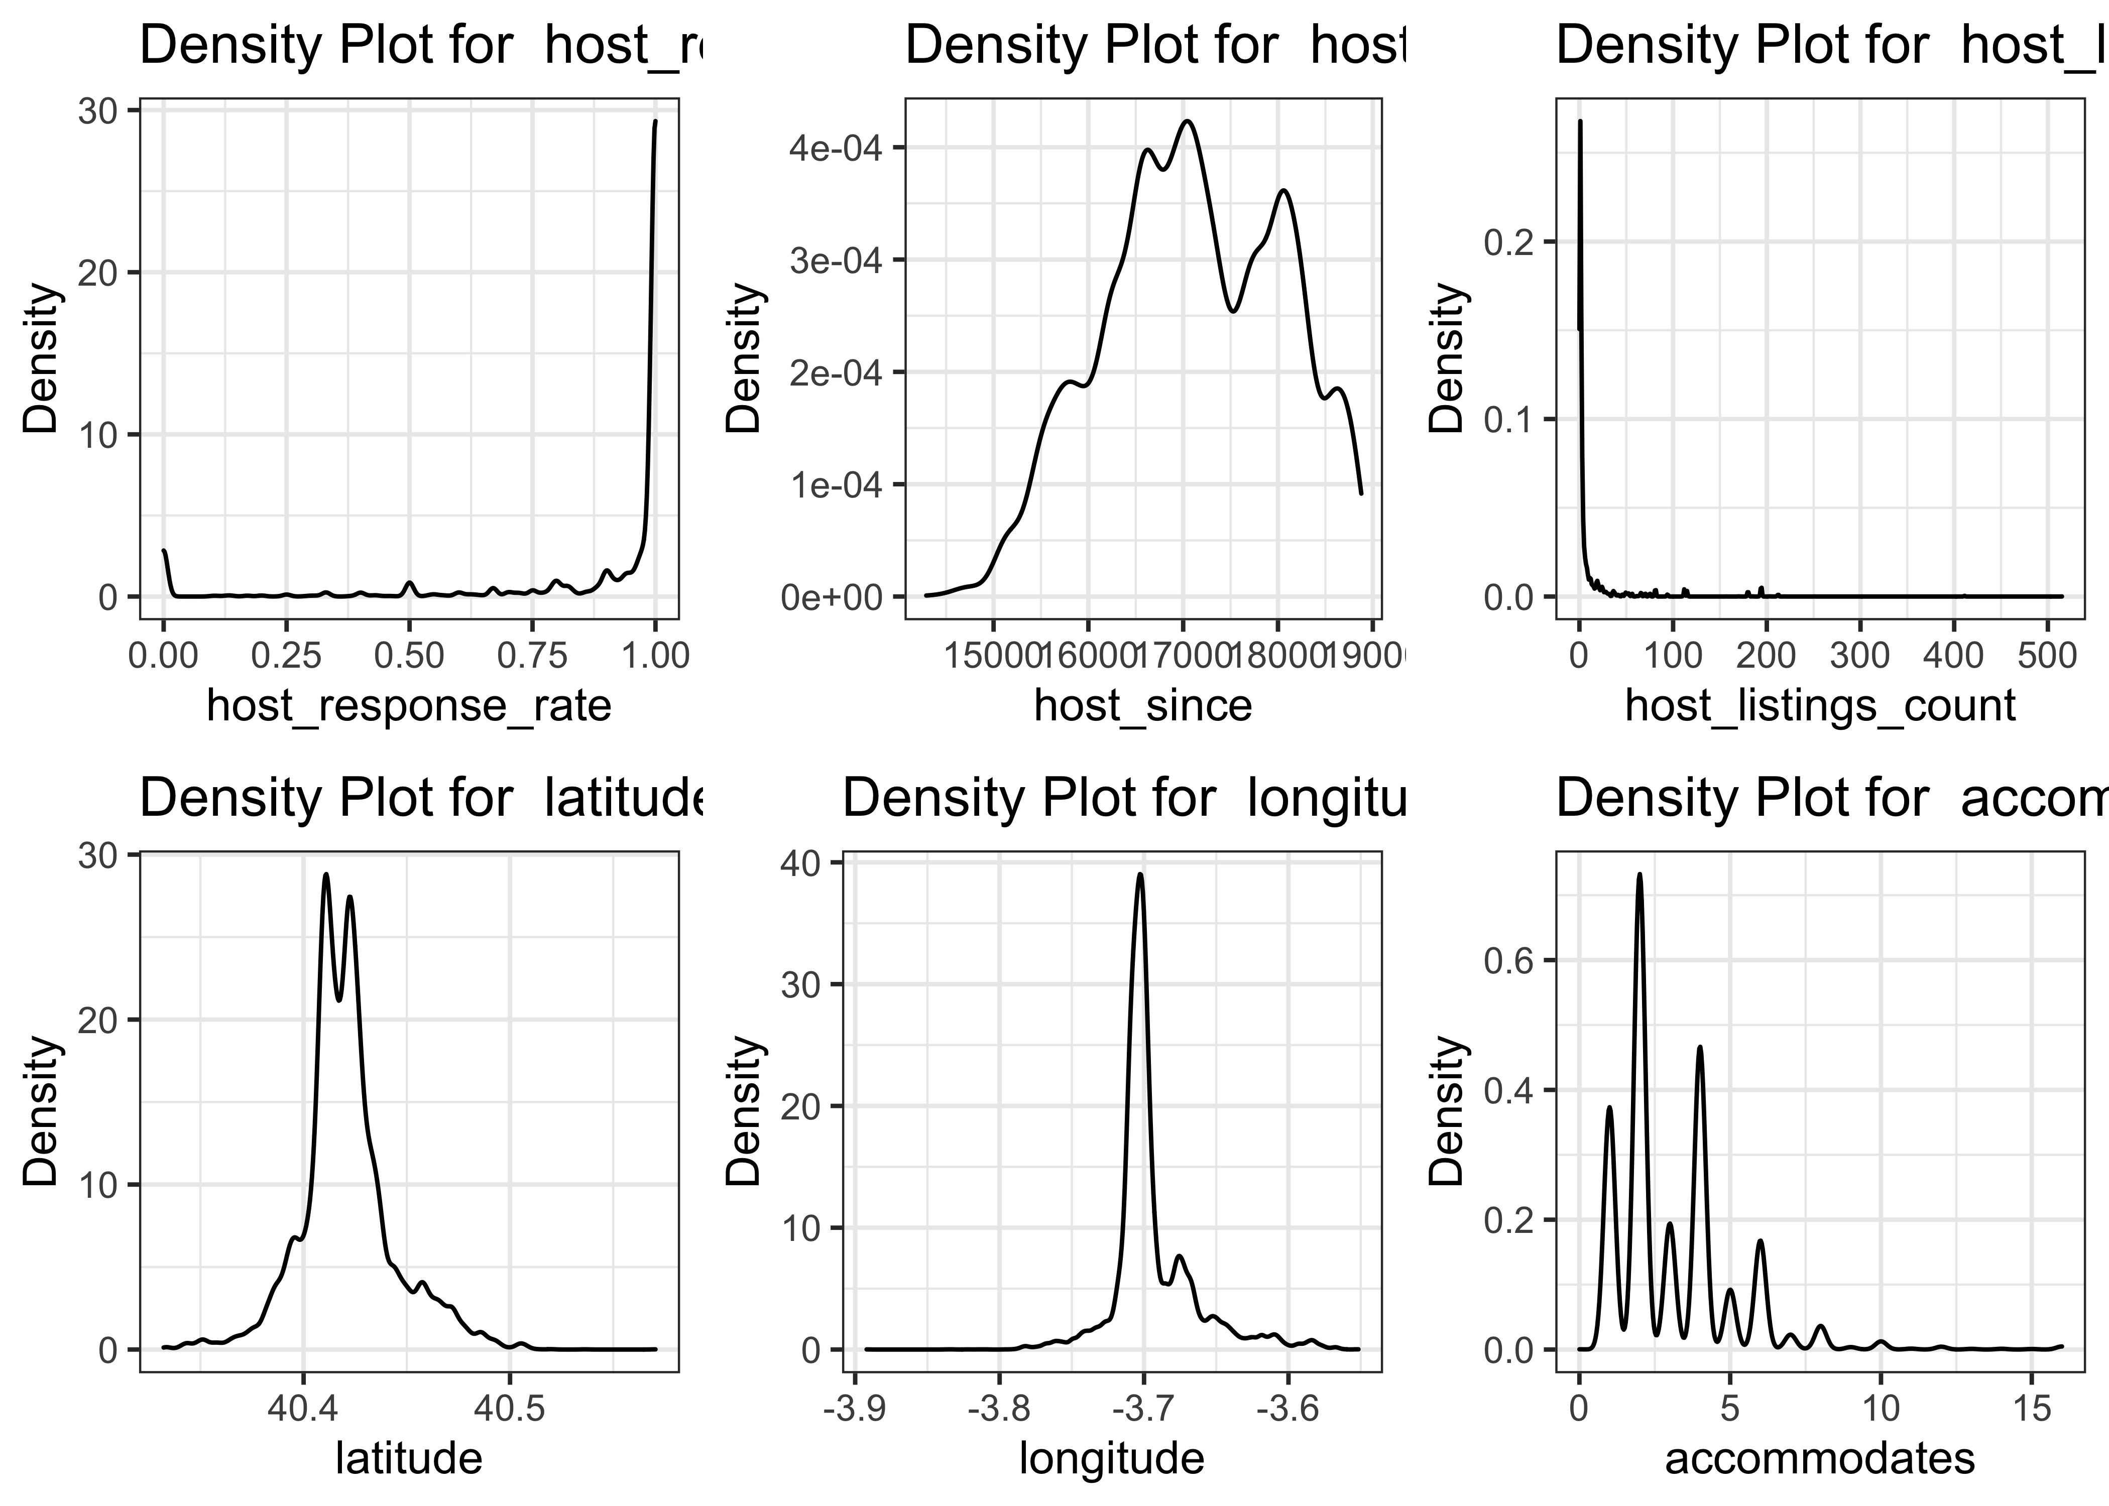
Exploratory Data Analysis
Description of Data
Key Variables
Categorical
After we had downloaded the raw data, we observed that there are:
74 variables
18,909 observations
37 variables in numeric (e.g., id or scrape_id)
25 variables in character (e.g., listing_url or name).
After we used histograms and bar plots to visualize the data we decided to focus on some key variables:
prop_type_simplified
neighbourhood_simplified
instant_bookable
availability_30
host_is_superhost
bathrooms
bedrooms
accommodates
review_scores_rating
reviews_per_month
Continuous
2

Slide 3
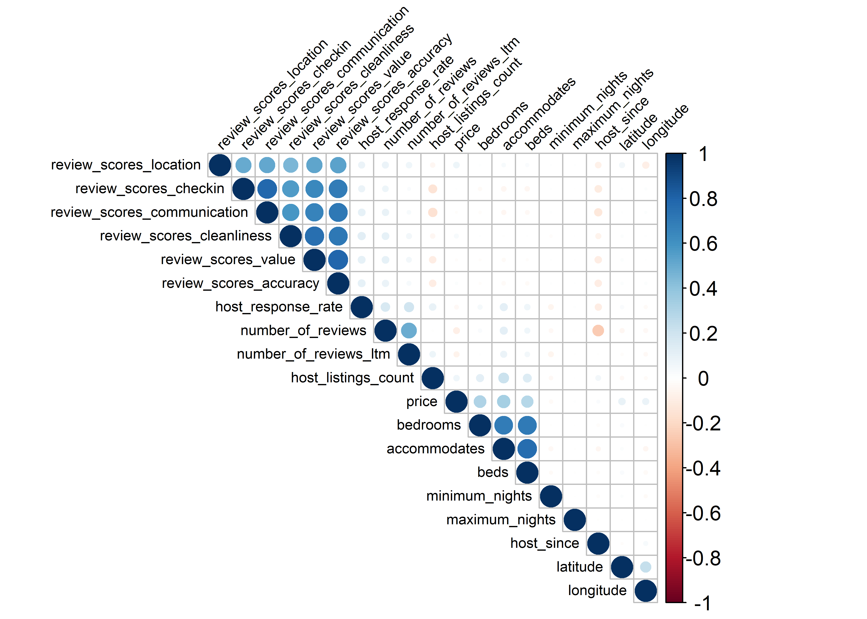
Correlation between all variables
Blue color shows positive correlation while red shows negative correlation
Some positively correlated variables are ‘beds’ and ‘accommodates’ or ‘review_score_value’ and ‘review_score_accuracy’
While host_since and number_of_review are negatively correlated
3

Slide 4
Regression Analysis
log(price_4_nights) = prop_type_simplified + number_of_reviews + review_scores_rating
0.19059% | 0.09145% | 0.75290% | 0.72267% | 0.16036% | 0.00162%
prop_type_simplifiedEntire rental unit | prop_type_simplifiedOther | prop_type_simplifiedPrivate room in rental unit | prop_type_simplifiedPrivate room in residential home | number_of_reviews | review_scores_rating
Holding the other variables, if the property is Entire rental, price_4_nights will increase by 0.1905927% (because a logarithmic transformation is performed on ‘price_4_nights’ variable). | Holding the other variables, if the property is Other, price_4_nights will decrease by 0.0914510% (because a logarithmic transformation is performed on ‘price_4_nights’ variable). | Holding the other variables, if the property is Private room in rental, price_4_nights will decrease by 0.7529075% (because a logarithmic transformation is performed on ‘price_4_nights’ variable). | Holding the other variables, if the property is Private room in residential home, price_4_nights will decrease by 0.7226708% (because a logarithmic transformation is performed on ‘price_4_nights’ variable). | Holding the other variables, each unit increase in number_of_reviews will increase price_4_nights by 0.1603604% (because a logarithmic transformation is performed on ‘price_4_nights’ variable). | Holding the other variables, each unit increase in review_scores_rating will increase price_4_nights by 0.0016925% (because a logarithmic transformation is performed on ‘price_4_nights’ variable).
4

Slide 5
Regression
Analysis
 | model1 | model2 | model3 | model4 | model5 | model6 | model7
(Intercept) | 5.137 *** | 5.171 *** | 4.625 *** | 4.671 *** | 4.645 *** | 4.727 *** | 4.428 ***
 | (0.091) | (0.089) | (0.081) | (0.083) | (0.084) | (0.083) | (0.080)
prop_type_simplifiedEntire rental unit | 0.191 *** | 0.190 *** | 0.063 | 0.059 | 0.056 | 0.008 | -0.011
 | (0.048) | (0.047) | (0.042) | (0.042) | (0.042) | (0.041) | (0.039)
prop_type_simplifiedOther | -0.091 | 0.198 *** | -0.097 * | -0.098 * | -0.101 * | -0.110 * | -0.194 ***
 | (0.052) | (0.055) | (0.045) | (0.045) | (0.045) | (0.045) | (0.042)
prop_type_simplifiedPrivate room in rental unit | -0.753 *** | -0.129 | -0.617 *** | -0.619 *** | -0.616 *** | -0.616 *** | -0.746 ***
 | (0.051) | (0.067) | (0.045) | (0.045) | (0.045) | (0.044) | (0.042)
prop_type_simplifiedPrivate room in residential home | -0.723 *** | -0.099 | -0.601 *** | -0.599 *** | -0.597 *** | -0.568 *** | -0.728 ***
 | (0.068) | (0.080) | (0.060) | (0.060) | (0.060) | (0.059) | (0.055)
number_of_reviews | -0.001 *** | -0.001 *** | -0.001 *** | -0.001 *** | -0.001 *** | -0.001 ***
 | (0.000) | (0.000) | (0.000) | (0.000) | (0.000) | (0.000)
review_scores_rating | 0.160 *** | 0.153 *** | 0.151 *** | 0.140 *** | 0.142 *** | 0.148 *** | 0.168 ***
 | (0.017) | (0.016) | (0.015) | (0.015) | (0.015) | (0.015) | (0.014)
room_typeHotel room |  | -0.018
 |  | (0.078)
room_typePrivate room |  | -0.624 ***
 |  | (0.045)
room_typeShared room |  | -1.205 ***
 |  | (0.135)
bathrooms |  |  | 0.139 *** | 0.138 *** | 0.138 *** | 0.130 *** | 0.136 ***
 |  |  | (0.014) | (0.014) | (0.014) | (0.013) | (0.012)
bedrooms |  |  | 0.059 *** | 0.060 *** | 0.061 *** | 0.069 *** | 0.072 ***
 |  |  | (0.012) | (0.012) | (0.012) | (0.012) | (0.011)
accommodates |  |  | 0.085 *** | 0.085 *** | 0.085 *** | 0.083 *** | 0.079 ***
 |  |  | (0.006) | (0.006) | (0.006) | (0.006) | (0.005)
host_is_superhost |  |  |  | 0.047 ** | 0.047 ** | 0.048 ** | 0.098 ***
 |  |  |  | (0.017) | (0.017) | (0.016) | (0.015)
instant_bookable |  |  |  |  | 0.026 | 0.009 | 0.063 ***
 |  |  |  |  | (0.015) | (0.014) | (0.014)
neighbourhood_simplifiedloop2 |  |  |  |  |  | 0.017 | 0.020
 |  |  |  |  |  | (0.020) | (0.019)
neighbourhood_simplifiedloop3 |  |  |  |  |  | -0.114 *** | -0.139 ***
 |  |  |  |  |  | (0.023) | (0.021)
neighbourhood_simplifiedloop4 |  |  |  |  |  | -0.251 *** | -0.293 ***
 |  |  |  |  |  | (0.021) | (0.020)
neighbourhood_simplifiedloop5 |  |  |  |  |  | -0.226 *** | -0.261 ***
 |  |  |  |  |  | (0.038) | (0.036)
availability_30 |  |  |  |  |  |  | 0.018 ***
 |  |  |  |  |  |  | (0.001)
reviews_per_month |  |  |  |  |  |  | -0.076 ***
 |  |  |  |  |  |  | (0.004)
N | 4516 | 4516 | 4516 | 4516 | 4516 | 4516 | 4516
R2 | 0.321 | 0.357 | 0.485 | 0.485 | 0.486 | 0.506 | 0.568
logLik | -3622.171 | -3496.718 | -2998.562 | -2994.685 | -2993.121 | -2904.859 | -2599.746
AIC | 7260.343 | 7015.436 | 6019.124 | 6013.370 | 6012.243 | 5843.719 | 5235.491
Based on model7, there are 14 variables (X) in total that are able to explain in the price for 4 night for 2 people
If you want to increase the occupancy rate of your hotel in Madrid, Spain, the most 2 important factors that should be improved are the review score rating and bathroom (number of available and cleanliness)
We would recommend that model7 be used for analysis as it has the highest value of R-squared at 0.568, which means that 56.8% of the data fit the regression model
5

Slide 6
Summary
Data Exploration
Model Selection
Findings
Summary
After we had imported the raw data, we select only the important variables that will have an impact on our analysis.
Then, we declare the variable types; double, character or logic, for example.
To make the property types more clarify, we classified it into 4 main groups which are
1) Entire rental unit
2) Private room in rental unit
3) Private room in residential home and
4) Entire loft and the remaining are Other.
We ensure data to meet the assumption; normal distribution by using log rather than linear line.
After that, we perform the regression analysis, as we add more variables in the regression model, the r-squared keep improving and those variables are statistically significant to explain Y.
Once we got the regression models, then we ran the diagnosis to check for homoscedasticity and made the conclusion in comparison table. In order to select the best model, R-squared represents a goodness-of-fit measure for linear regression models, meaning that higher R-squared is better.
As a result, we would suggest you to use the model7 that has the highest value of R-squared at 0.568, so that 56.8% of the data fit the regression model.
Focusing on significant variables,ceteris paribus, an increase 1) review_scores_rating 2) bathrooms 3) bedrooms 4) accommodates 5) host_is_superhost 6) instant_bookable and 7) availability_30 will increase the price for 4 nights.
Focusing on significant variables, ceteris paribus, an increase in 1) prop_type_simplifiedOther 2) prop_type_simplifiedPrivate room in rental unit 3)prop_type_simplifiedPrivate room in residential home 4)neighbourhood_simplifiedloop3 5) neighbourhood_simplifiedloop4 6) neighbourhood_simplifiedloop5 and 7) reviews_per_month will decrease the price for 4 nights.
Even though the models are acceptable but the residuals are not normally distributed, so it obey the basic assumptions of OLS regression. Therefore, to improve the analysis, the next step is to modify the residuals to make it normally distributed. To do so, we can use BOX-COC method.
Our best model is model7 as 56.8% of the data fit this regression model which represent the highest value of r-squared.
There are 14 variables (X) in total that are able to explain in the price for 4 night for 2 people (Y).
The most 2 important factors that cost the higher price of hotel in Madrid, Spain are the review score rating and bathroom (number of available and cleaness).
However, property types and locations have a negative impact on price for 4 night for 2 people. For example, the higher distance from central will cost the hotel for 4 nights for 2 propel to be lower such as Latine, San Blas - Canillejas or Hortaleza.
6

Slide 7
Model 1
`
B15
`````
Thank you
Introduction to our visual system
2017

